Slide 1

Introduction to algorithms computational algorithms
Lecture II
30 September 2021

Slide 2
Announcement!!
NO LECTURE NEXT
THURSDAY 7 OCTOBER.
THERE WILL BE SEMINARS ON
FRIDAY 8 OCTOBER.
SEMINAR 2 CLASSES WILL BEGIN FROM 11 OCTOBER

Slide 3

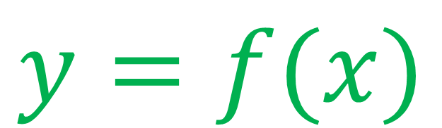

Computational procedures/algorithms
$$x$$
$$y$$
function
algorithm
INPUT
OUT
PUT
arguments
Numerical value
String or character
Data structure (list)
$$y=f(x)$$
Numerical value
String or character
Data structure (list)

Slide 4
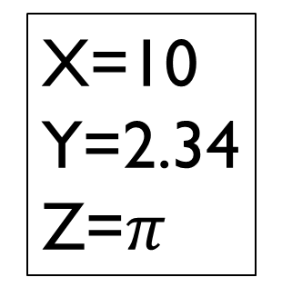
variables
A variable is a container that holds a value
Numerical Value
Character/String
Boolean
X=10
Y=2.34
Z=$π$
X=‘a’
Y=‘*’
Z=‘9’
X=‘hello’
Y=‘ningbo’
Z=‘9/9/21’
Quotation mark
‘ ’

Slide 5
Boolean variable (Logical variable)
A Boolean variable can only take two values:
TRUE (1)
T
FALSE (0)
F
Computers often return 1 for True and 0 for False

Slide 6
Arithmetic operations on numerical variables
OPERATOR
ACTION
+
addition
_
subtraction
*
multiplication
/
integer division
% (mod)
remainder

Slide 7
Examples – computational statements
5/2 =
2
5%2 =
1
5=2x2+1
15/4 =
3
15%4 =
3
15=3x4+3
remainder
90/10 =
9
90%10 =
0
90=9x10+0
90 is divisible by 10

Slide 8
Boolean statements/operators
Boolean statements can be either FALSE or TRUE
Boolean statements contain Boolean operators
==
7==2
FALSE
equality
!=
7!=2
TRUE
inequality
>=
greater or equal
7>=2
TRUE
<=
less or equal
7<=2
FALSE

Slide 9
Compounded Boolean statements
Suppose that P and Q are
Boolean statements.
We can make a new
Boolean statement by
compounding P and Q.
Boolean statements
can be compounded using
relational operators:
AND -- OR
P AND Q
AND (P,Q)
P && Q
Compounded
statements
P OR Q
OR (P,Q)
P || Q

Slide 10
Boolean values for AND(P,Q)
The statement AND(P,Q),
is TRUE only when both
Boolean variables are TRUE,
otherwise FALSE.
TRUTH TABLE
P
Q
AND(P,Q)
F
F
F
F
T
F
T
F
F
T
T
T

Slide 11
Boolean values for OR(P,Q)
The statement OR(P,Q),
is TRUE when at least one of
Boolean variables is TRUE,
otherwise FALSE.
TRUTH TABLE
P
Q
OR(P,Q)
T
F
T
F
T
T
T
T
T
F
F
F

Slide 12
Conditional blocks: if-then-else
condition
Boolean statement
true
false
ONLY ONE ACTION IS EXECUTED!
take action 1
take action 2

Slide 13
Example (two outcomes)
Decide if students passed or failed the final exam.
condition (Boolean statement)
if student_grade >= 50 then
return ‘PASS’
else
return ‘FAIL’
endif
(if student_grade < 50)

Slide 14




Example (more than two outcomes)
if student_grade >= 85 then
return ‘A’
elseif student_grade >= 70 then
return ‘B’
elseif student_grade >= 50 then
return ‘C’
else
return ‘D’
endif
Grade
Letter
$$≥85$$
A
$$≥70$$
B
$$≥50$$
C
$$<50$$
D

Slide 15
Trace – check if algorithm works correctly!!
1. if student_grade >= 85 then
2. return ‘A’
3. elseif student_grade >= 70 then
4. return ‘B’
5. elseif student_grade >= 50 then
6. return ‘C’
7. else
8. return ‘D’
9. endif
student_grade=68
Line 1. is student_grade >= 85?
NO
GOTO Line 3
Line 3. is student_grade >= 70?
NO
GOTO Line 5
Line 5. is student_grade >= 50?
YES!
GOTO Line 6
Line 6. return ‘C’
GOTO Line 9
Skip out of if-block

Slide 16
Proper algorithm (with header)
Algorithm: grades_to_letters(n)
Requires: an integer n; n>0 and n<101
Returns: a letter A, B, C or D
1. if n >= 85 then
2. return ‘A’
3. elseif n >= 70 then
4. return ‘B’
5. elseif n >= 50 then
6. return ‘C’
7. else
8. return ‘D’
9. endif

